Slide 1
Oracle's Distributed Database

Slide 2
Definition
A Distributed Database is a set of databases stored on multiple computers at different locations and it appears to the user as a single database.
The locations of the distributed database may be spread over a large area around the world, or over a small area such as one building.

Slide 3
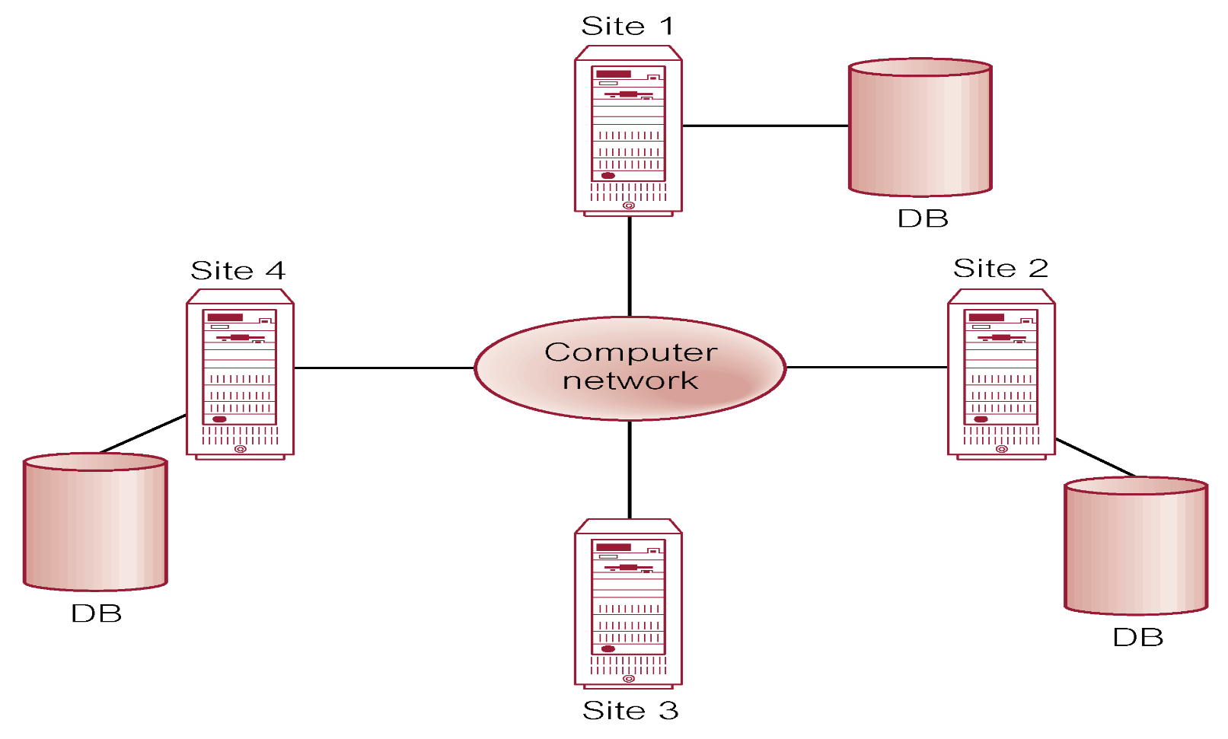
Distributed DBMS

Slide 4
Why A Distributed Database?
Reflects organizational structure
Improved shareability and local autonomy
Improved availability
Improved reliability
Improved performance
Economics
Modular growth

Slide 5
Why Not A Distributed Database?
Complexity
Cost
Security
Integrity control more difficult
Lack of standards
Lack of experience
Database design more complex

Slide 6
Why A Distributed Database?
To provide the users with easy access to data at many different locations that divisions, department, and facilities of modern organizations are geographically distributed.
Data sharing will always be there, so it must be convenient and consolidated.
Transferring large amount of data across the network can be very costly and will affect the network performance.

Slide 7
Oracle Client/Server Concept
The software that manages the database is called the database server
An application that requests information from that server is the client or a node

Slide 8
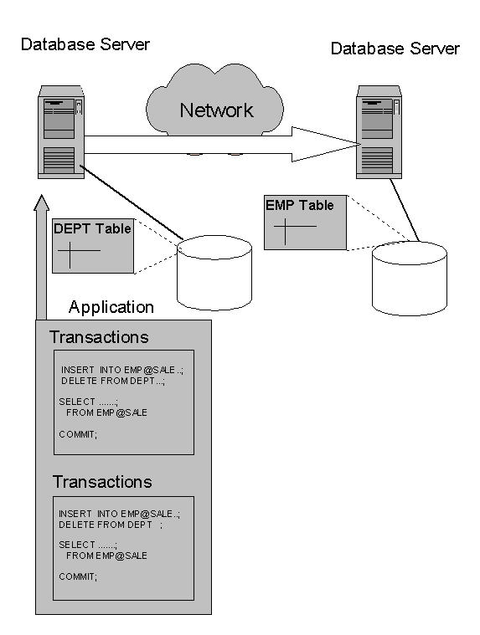
A client can connect to the database server either directly or indirectly

Slide 9
The Network Connection
Net8 is an Oracle's network software that provides the inter-database communications across the network.
Net8 performs all its operations independent of the network operating system (NOS).

Slide 10
Database Replication
It is the process of storing a copy of the database at each location of the distributed database system.

Slide 11
advantages:
Reliability: If one site containing the database fails, a copy can always be accessed at another site.
Fast response time: Each site has a local copy of the database, so queries can be executed faster.
Node decoupling: Transaction may proceed without coordination across the network.
Improve performance by minimizing the network traffic at prime time

Slide 12
disadvantages
Storage requirements: Each site must storage capacity to store copy of the database.
Complexity and cost of updating: When updating the database, all sites must be updated.

Slide 13
Heterogeneous Distributed Database
One of the database systems may not be an oracle database system called heterogeneous distributed database system
and services are handled by an Oracle software called Oracle Gateway.

Slide 14
Transparency in a Distributed Database System
Location transparency which allows application developers and administrators to hide the physical location of the database

Slide 15
Location Transparency
It has two major advantages:
Access to remote database objects will be very simple.
Database objects can be moved with no impact on the user's applications.

Slide 16
Administration of an Oracle Distributed Database System
Local Autonomy each server in a distributed database system is administered independently from all other databases

Slide 17
benefit of local autonomy
Administrator's responsibility is smaller and their database is more manageable.
Failure of an independent system has no effect on other nodes.
Recovery from isolated failures also has no effect on other nodes.
Each local database has its own data dictionary.
Upgrades can be done independently for each database.

Slide 18
Security Issues
As with a non-distributed database, all security features are supported in a distributed database system.

Slide 19
User Accounts and Roles
User accounts and roles must be available in all databases of the distributed database system
the Net8 Advanced Networking Option protects the data from an unauthorized viewing and ensures that data has not been modified, updated, or deleted during transmission

Slide 20
Administration tools for an Oracle Distributed Database System
Oracle Enterprise Manager: A GUI version and a command mode version are available.
Third-party administration tools: More than 60 products from different companies are available to manage Oracle distributed database.
SNMP (Simple Network Management Protocol): Beside its network management tasks, it can be used to locate and query and Oracle server.

Slide 21
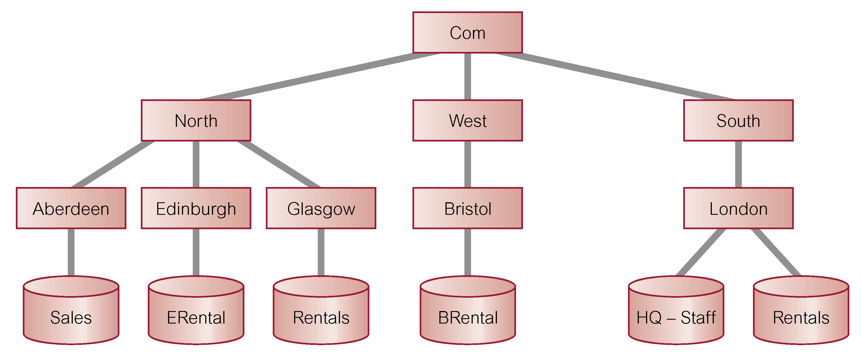
Global Database Names
Each distributed database is given a global database name, distinct from all databases in system. Name formed by prefixing database’s network domain name with local database name. Domain name must follow standard Internet conventions.

Slide 22
Database Links (Cont.)
DDBs in Oracle are built on database links, which define communication path from one Oracle database to another.
Purpose of database links is to make remote data available for queries and updates, essentially acting as a type of stored login to the remote database.
For example:
  CREATE PUBLIC DATABASE LINK
  RENTALS.GLASGOW.NORTH.COM;

Slide 23
Database Links
Once database link has been created, it can be used to refer to tables and views on the remote database by appending @databaselink to table or view name.
For example:
  SELECT *
  FROM Staff@RENTALS.GLASGOW.NORTH.COM;

Slide 24
Thanks

